Slide 1
GNCIPL · CYBERSECURITY PROJECT
Data Breach Analysis
by Industry
Domain: Cybersecurity | Tools: Python · Pandas · NumPy · Matplotlib
Dataset: Kaggle — df_1.csv | 352 records, 6 columns | CC0 Public Domain
By Riya Motghare

Slide 2
About the Dataset
352
304
61
Total Rows
Clean Rows
Industries
before cleaning
after wrangling
unique sectors
Dataset Columns (df_1.csv)
Unnamed: 0
Entity
Year
Row index
Name of breached organization
Year breach occurred
Records
Organization type
Method
Records compromised (Integer)
Industry / sector
How the breach happened

Slide 3
The project focuses on analyzing a dataset of historical data breaches. The main objectives are: 1. Clean and prepare raw breach data. 2. Identify industries with the highest number of breaches. 3. Analyze breach trends over different years. 4. Calculate the total number of records affected. 5. Find which industries suffered the largest data losses. 6. Visualize the results using charts for better understanding.

Slide 4
Project Workflow
01
02
03
Load Dataset
Import Libraries
Data Cleaning
Upload df_1.csv via Colab file picker; read with pd.read_csv()
pandas, numpy, matplotlib.pyplot imported
Check nulls (Records: 2, Method: 1, Sources: 2), drop missing rows → 305 rows
04
05
06
Rename & Format
Fix Data Types
EDA & Visualize
Rename columns: Entity→organization, Records→records_affected, etc.
Convert records to numeric, year to int, strip extra spaces from industry
Bar chart, line chart for breach trends + Q&A analysis

Slide 5
Data Wrangling — Actual Code
# Step 1: Check missing values
Missing Values Output:
print(df.isnull().sum())
Unnamed: 0 0
# Records:2 Method:1 Sources:2
Entity 0
# Step 2: Rename columns
Year 0
df.rename(columns={
Records 2
'Entity':'organization',
Organization type 0
'Records':'records_affected',
Method 1
'Organization type':'industry'
Sources 2
}, inplace=True)
# Step 3: Drop nulls → 305 rows
After Cleaning
df.dropna(subset=['industry',
352 → 305 rows (47 rows dropped)
'records_affected','year'])
# Step 4: Fix data types
df['year'] = df['year'].astype(int)
Duplicates Removed
Final clean dataset: 304 rows × 7 cols

Slide 6
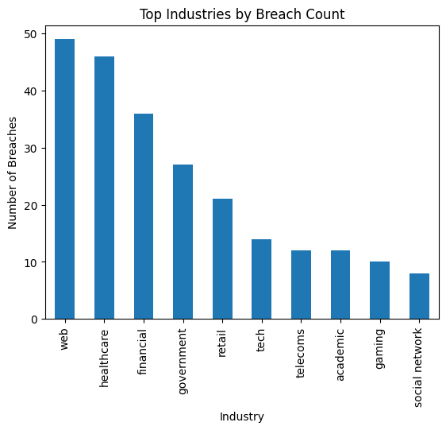
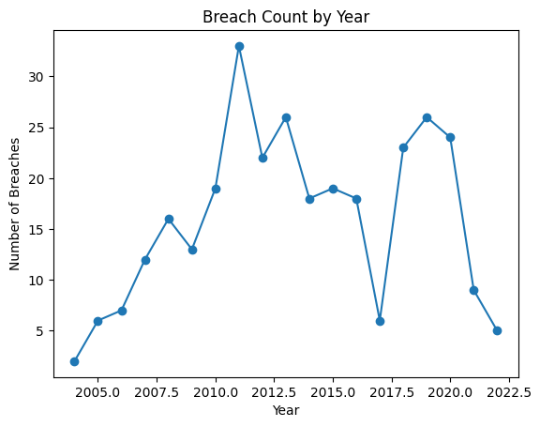
Project Output — Charts
📊
📈
Chart 1
Chart 2
Breach Count by Year (2004–2022)
Top Industries by Breach Count
web=49 · healthcare=46 · financial=36
Peak: 2011 with 33 breaches

Slide 7
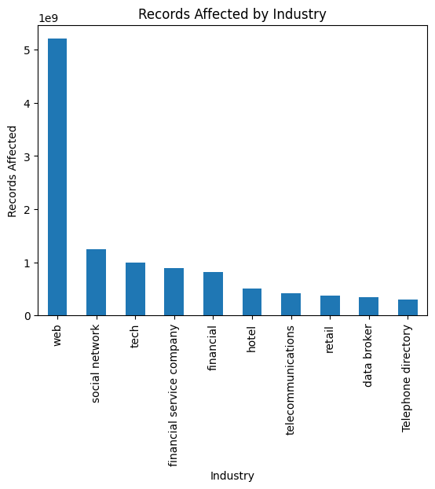
Project Output — Charts
Chart 3 — Records Affected by Industry:
web: 5.2B · social network: 1.2B · tech: 1.0B · financial: 818M

Slide 8
Analytical Questions & Answers
Q1. Which industry had the most data breaches?
Breach Count
Q2. Which year recorded the highest breach count?
Yearly Trend
Web industry — 49 breaches. It stores large amounts of user and business data, making it the top target for cyberattacks.
2011 — with 33 breaches. This spike is linked to greater digital adoption and more sophisticated cyber threats that year.
Q3. Which industry had the most records exposed?
Records Exposed
Q4. How many total records were exposed overall?
Total Impact
Web industry — over 5.2 billion records (5.203696e+09). A single large breach can expose more records than many smaller breaches combined.
13,357,968,650 records (13.3 billion) across all 304 reported breaches — highlighting the massive scale of cybersecurity risk.

Slide 9
Conclusion
✓ Loaded df_1.csv (352 rows) — checked & fixed nulls, types, duplicates → 304 clean rows
✓ Performed EDA: 61 unique industries identified, top sector is Web (49 breaches)
✓ Yearly trend shows 2011 as the peak year with 33 breach incidents
✓ Total 13.3 billion records exposed — showing the massive scale of cybersecurity risk

